Slide 1
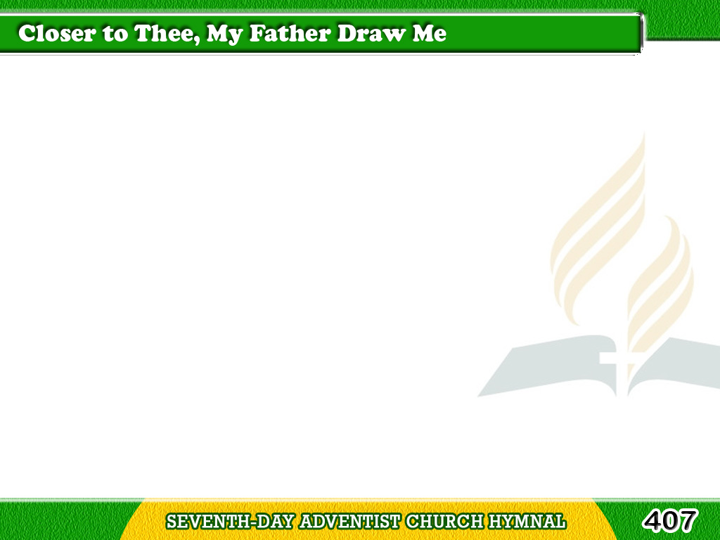
1/3
Closer to Thee,
my Father, draw me,
I long for Thine embrace;
Tagalog
Version

Slide 2
1/3
Closer within
Thine arms enfold me,
I seek a resting place.
Tagalog
Version

Slide 3
1/3
Chorus
Closer with the cords of love,
Draw me to Thyself above;
Closer draw me,
To Thyself above.
Tagalog
Version

Slide 4
2/3
Closer to Thee,
My Saviour, draw me,
Nor let me leave Thee more;
Tagalog
Version

Slide 5
2/3
Fain would I feel
Thine arms around me,
And count my wanderings o’er.
Tagalog
Version

Slide 6
2/3
Chorus
Closer with the cords of love,
Draw me to Thyself above;
Closer draw me,
To Thyself above.
Tagalog
Version

Slide 7
3/3
Closer by Thy
sweet Spirit draw me,
Till I am all like Thee;
Tagalog
Version

Slide 8
3/3
Quicken, refine,
and wash, and cleanse me,
Till I am pure and free.
Tagalog
Version

Slide 9
3/3
Chorus
Closer with the cords of love,
Draw me to Thyself above;
Closer draw me,
To Thyself above.
Tagalog
Version

